Slide 1
Deep Learning Era
Sameer mahajan

Slide 2
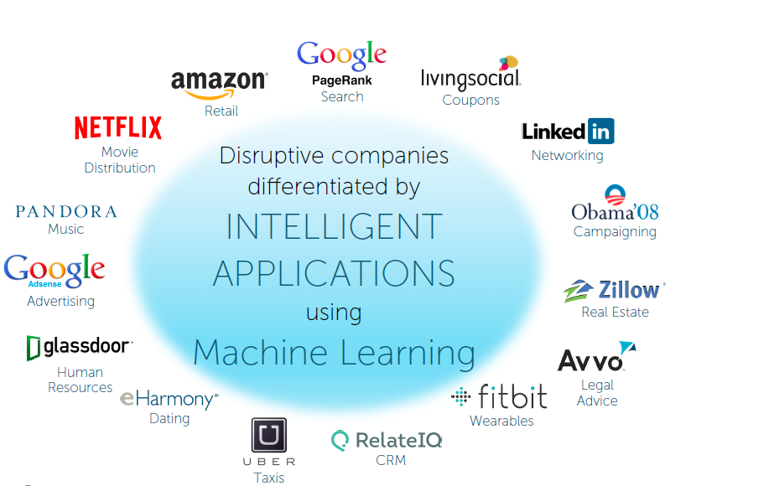

Slide 3
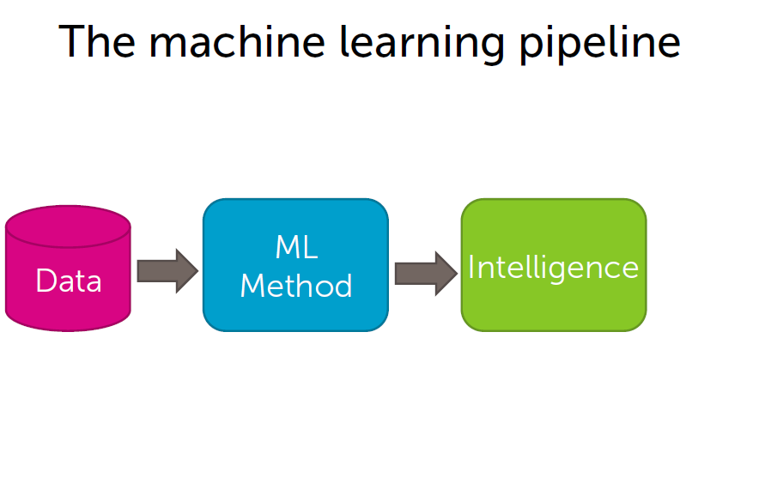
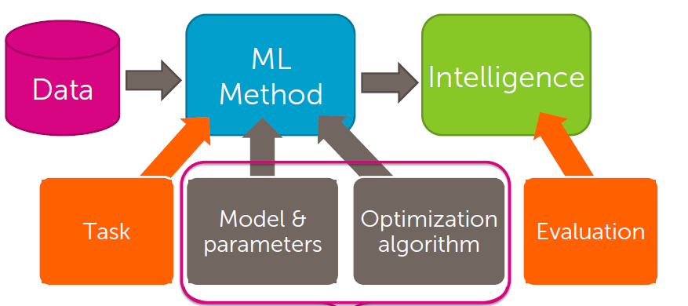

Slide 4
Types of problems and solutions
Regression: real valued output, predicting house prices
Classification: product reviews
Clustering: unsupervised learning, document retrieval
Recommender systems: product recommendation
Deep learning: neural networks

Slide 5
Introduction
Jupyter notebook
Python
Numpy
Pandas
Scikit learn

Slide 6
Commands to remember
sudo docker run -it -p 8888:8888 gcr.io/tensorflow/tensorflow (to run the preinstalled container)
http://localhost:8888/?token=<token id> (to connect to jupyter notebook)
sudo docker ps (to get container id of running container)
sudo docker exec -it <container id> bash (to enter the container)

Slide 7
Regression
Predicting house prices
Linear regression

Slide 8
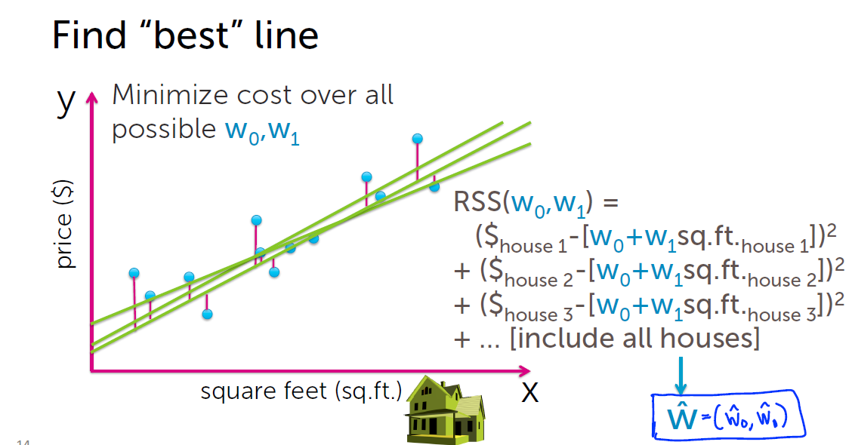

Slide 9
Classification
Sentiment analysis
Analyze restaurant reviews

Slide 10
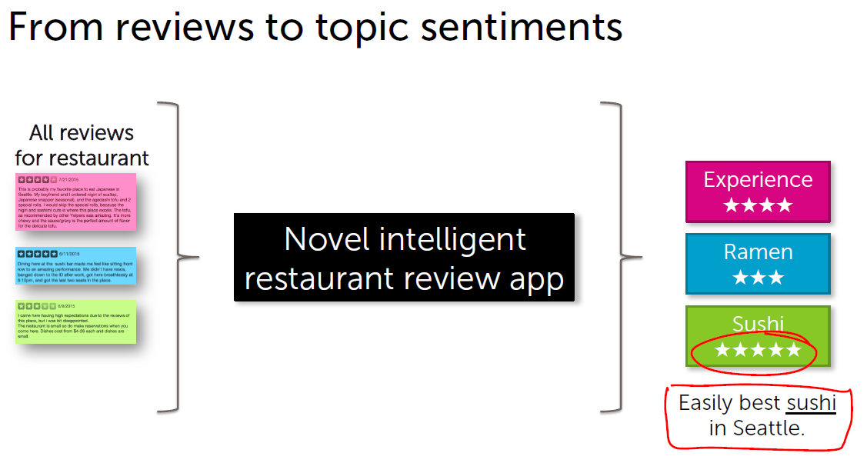

Slide 11
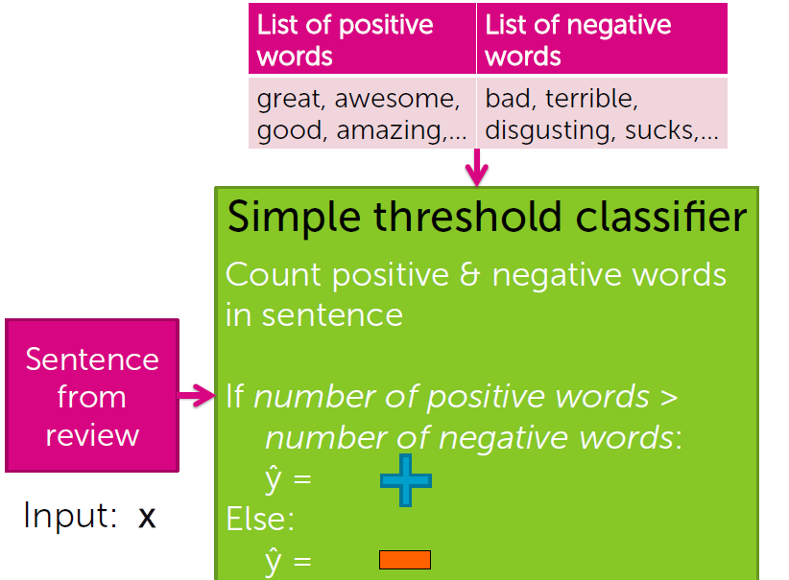

Slide 12
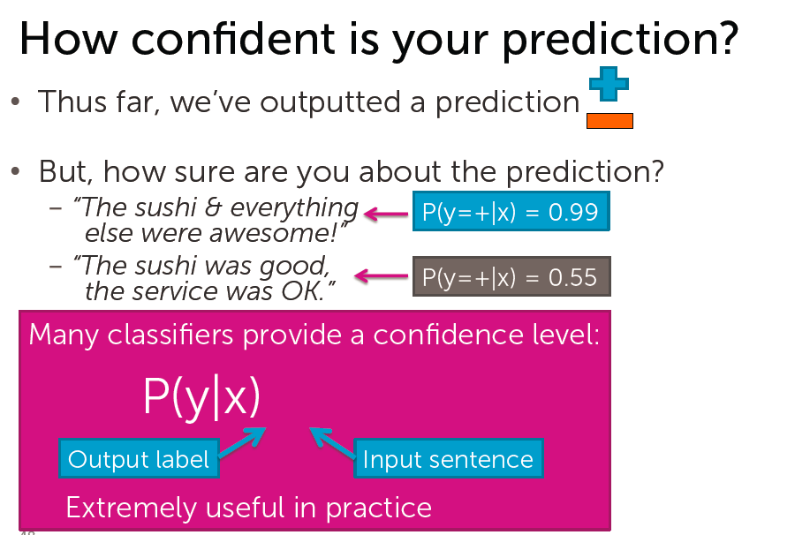

Slide 13
Title and Content Layout with Chart

Slide 14
Two Content Layout with Table
Class | Group A | Group B
Class 1 | 82 | 85
Class 2 | 76 | 88
Class 3 | 84 | 90
First bullet point here
Second bullet point here
Third bullet point here

Slide 15
Two Content Layout with SmartArt
First bullet point here
Second bullet point here
Third bullet point here
Group A
Task 1
Task 2
Group B
Task 1
Task 2
Group C
Task 1

Slide 16
Add a Slide Title - 1

Slide 17
Add a Slide Title - 2

Slide 18
Add a Slide Title - 3

Slide 20
Add a Slide Title - 4

Slide 21
Add a Slide Title - 5

